Slide 1

RECOVERY OF RARE EARTH METALS FROM LAPTOP PERMANENT MAGNETS
A POWERPOINT PRESENTATION
Submitted in partial fulfillment of the Requirements for the award of the Degree of
BACHELOR OF TECHNOLOGY
In
METALLURGICAL ENGINEERING
By
VARDHINI SIVANGI (17011A0646)
VIJVAL VEMULA (17011A0651)
Under the esteemed guidance of
EXTERNAL GUIDE:
Dr. U. RAMBABU
Senior Scientist & Head of RoHS Department, C-MET, HCL-Post, Cherlapally, Hyderabad
INTERNAL GUIDE:
Dr. B. RAMESH CHANDRA
Associate Professor
Metallurgical Engineering
JNTUH College of Engineering, Hyderabad
DEPARTMENT OF METALLURGICAL ENGINEERING
JAWAHARLAL NEHRU TECHNOLOGICAL UNIVERSITY HYDERABAD
COLLEGE OF ENGINEERING (AUTONOMOUS)
HYDERABAD – 500 085
TELANGANA
2021

Slide 2
ABSTRACT
NdFeB permanent magnets have different life cycles, depending on the applications: from as short as 2–3 years in consumer electronics to 20–30 years in wind turbines. The size of the magnets ranges from less than 1 g in small consumer electronics to about 1 kg in electric vehicles (EVs) and hybrid and electric vehicles (HEVs), and can be as large as 1000–2000 kg in the generators of modern wind turbines. NdFeB permanent magnets contain about 31–32 wt% of rare-earth elements (REEs). Recycling of REEs contained in this type of magnets from the End-of-Life (EOL) products will play an important and complementary role in the total supply of REEs in the future. However, collection and recovery of the magnets from small consumer electronics imposes great social and technological challenges. This paper gives an overview of the sources of NdFeB permanent magnets related to their applications, followed by a summary of the various available technologies to recover the REEs from these magnets, including physical processing and separation, direct alloy production, and metallurgical extraction and recovery. At present, no commercial operation has been identified for recycling the EOL NdFeB permanent magnets and the recovery of the associated REE content. Most of the processing methods are still at various research and development stages. It is estimated that in the coming 10–15 years, the recycled REEs from EOL permanent magnets will play a significant role in the total REE supply in the magnet sector, provided that efficient technologies will be developed and implemented in practice.
Keywords: NdFeB Permanent magnets, Rare-Earth Elements (REEs), Electronics, Electrical Vehicles, Hybrid Electrical Vehicles

Slide 3
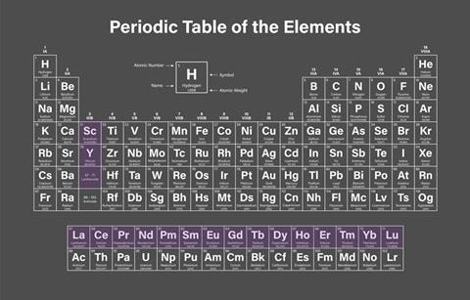
INTRODUCTION
REE – Lanthanum to Lutetium (57-71)
Very Expensive for their rare presence in nature.
Difficult to extract due to their similar chemical properties.
Majority of the world reserves bound only in Chinese Provinces.
Mainly used in NdFeB magnets, like the permanent magnets in laptops, PCs and other electronic items.
NdFeB magnets are very expensive, present market value is about ₹6000/- per Kg.
These magnets contain about 30wt% Rare earth elements, and Nd being key REE in its composition.

Slide 4
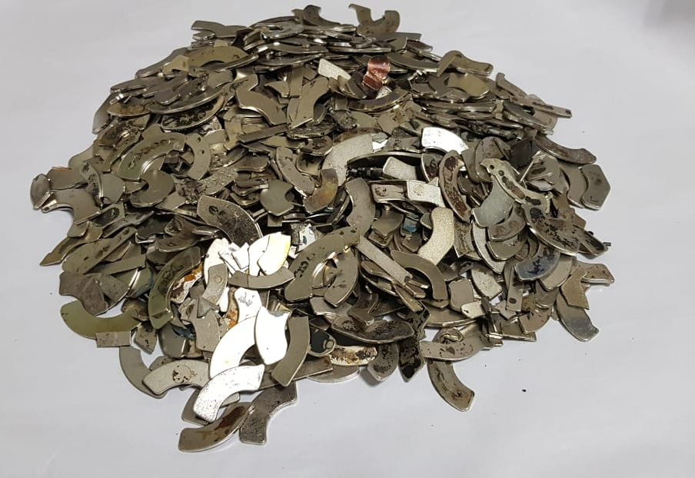
LAPTOP PERMANENT MAGNETS
Demagnetized
These are the NdFeB permanent magnets found in Laptops

Slide 5
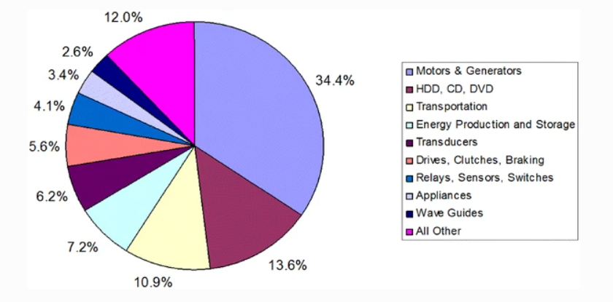
SHARES OF DIFFERENT APPLICATIONS OF NdFeB PM

Slide 6
FLOWCHART OF THE PROCESS
NdFeB permanent magnets from Laptops
Demagnetization (heating above curie temperature (~ 400-450ºC))
Pulverization (crushing/cutting)
Acid Leaching (with ~5.06 M H₂SO₄)

Slide 7
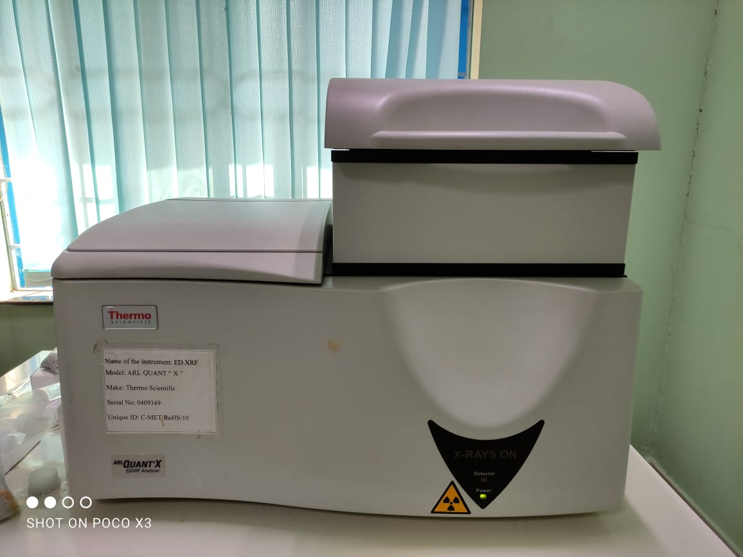
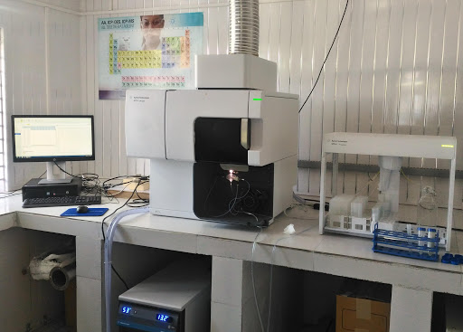
ELEMENTAL ANALYSIS METHODS USED
Energy Dispersive X-Ray Fluorescence (EDXRF) Analysis
Inductively Coupled Plasma – Optical Emission Spectroscopy (ICP – OES)

Slide 8
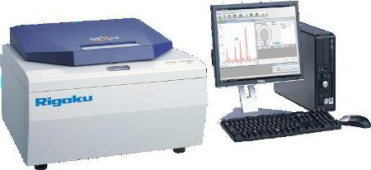
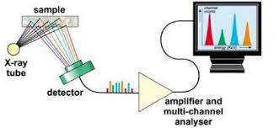
ED - XRF
Energy Dispersive X-ray Fluorescence (EDXRF) is one of two general types of X-ray Fluorescence techniques used for elemental analysis applications. In EDXRF spectrometers, all of the elements in the sample are excited simultaneously, and an energy dispersive detector in combination with a multi-channel analyzer is used to simultaneously collect the fluorescence radiation emitted from the sample and then separate the different energies of the characteristic radiation from each of the different sample elements. Resolution of EDXRF systems is dependent upon the detector, and typically ranges from 150 eV – 600 eV. The principal advantages of EDXRF systems are their simplicity, fast operation, lack of moving parts, high source efficiency, nondestructive, rapid, multielement, highly accurate, and environment friendly analysis compared with other elemental detection methods. A hardware setup is designed in this project for the elemental analysis of samples obtained at different stages of the process.

Slide 9
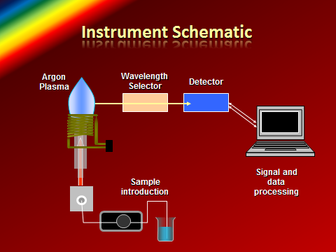
ICP - OES
Inductively coupled plasma optical emission spectroscopy (ICP-OES) is the technique of choice for many different applications, including those in the environmental, metallurgical, geological, petrochemical, pharmaceutical, materials, and food safety arenas. It can be applied to varying sample types such as aqueous and organic liquids and solids. Some of these sample types need specific sample preparation techniques or the use of specific accessories.
The advantages of using ICP-OES over other elemental analysis techniques such as inductively coupled plasma mass spectrometry (ICP-MS) or atomic absorption spectrometry (AAS) include its wide linear dynamic range, high matrix tolerance, and the enhanced speed of analysis that can be achieved.

Slide 10
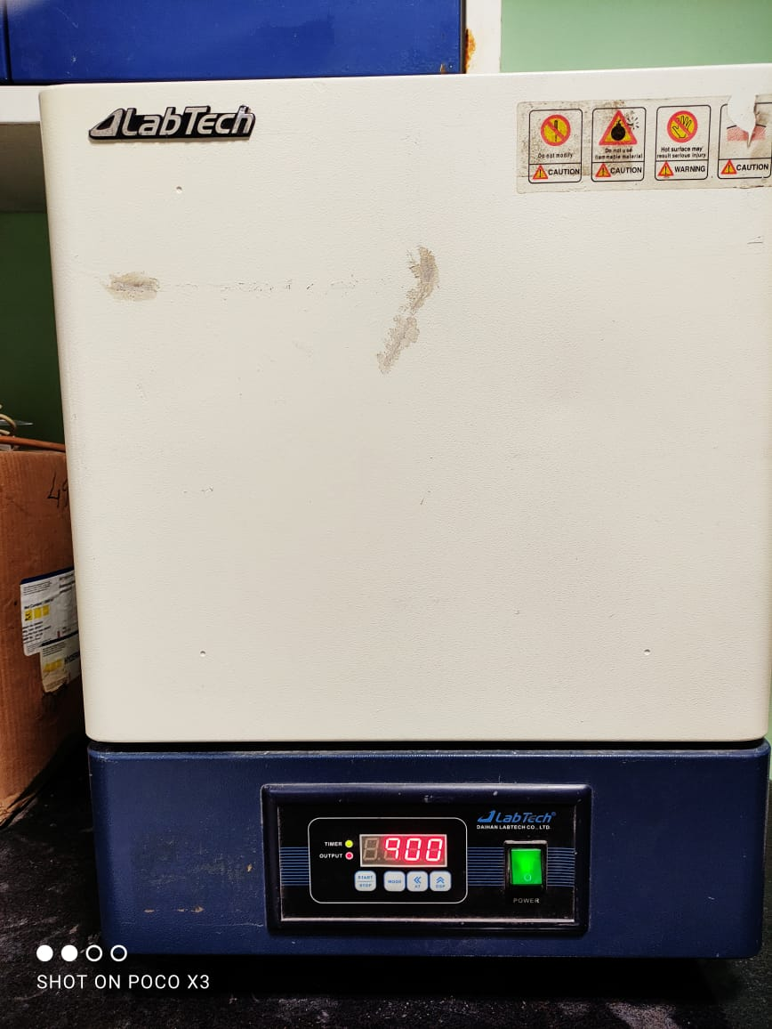
PROCESS
A. COLLECTION OF NdFeB PERMANENT MAGNETS FROM LAPTOPS:
B. DEMAGNETIZATION OF THE MAGNETS :
The Magnets are heated in oven above the curie temperature
i.e., 400-450ºC for about an hour
The useless laptops from different parts of country are collected,
and the magnets are stored before shredding the laptops

Slide 11
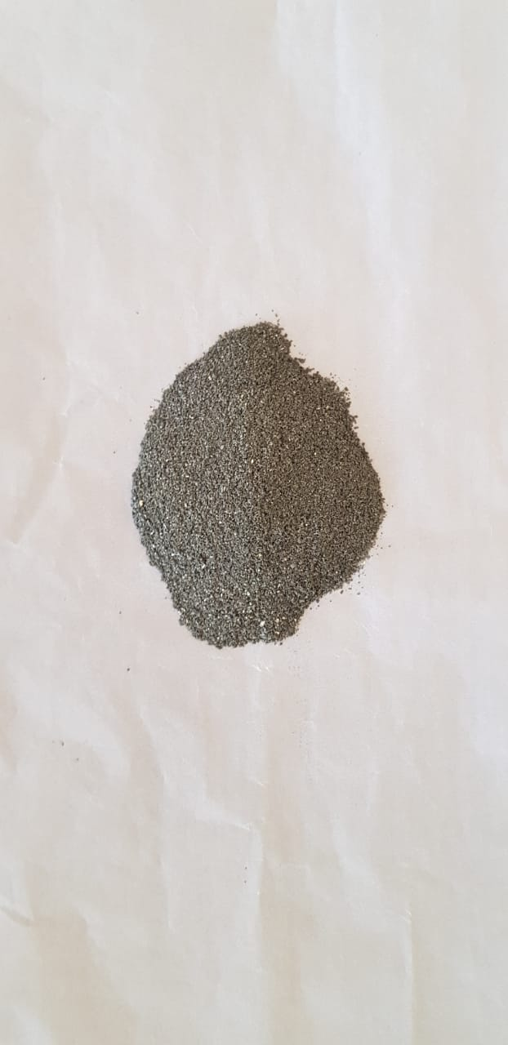
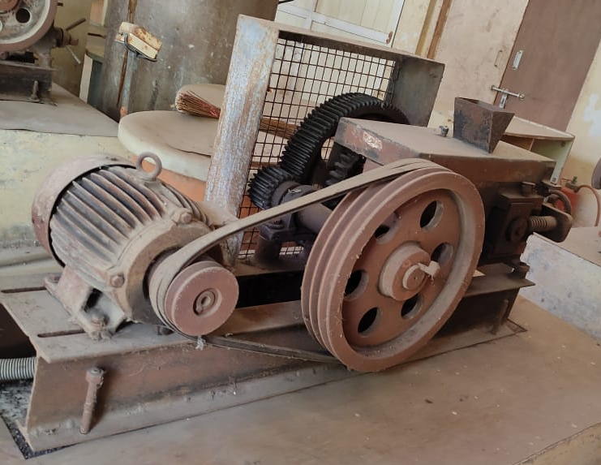
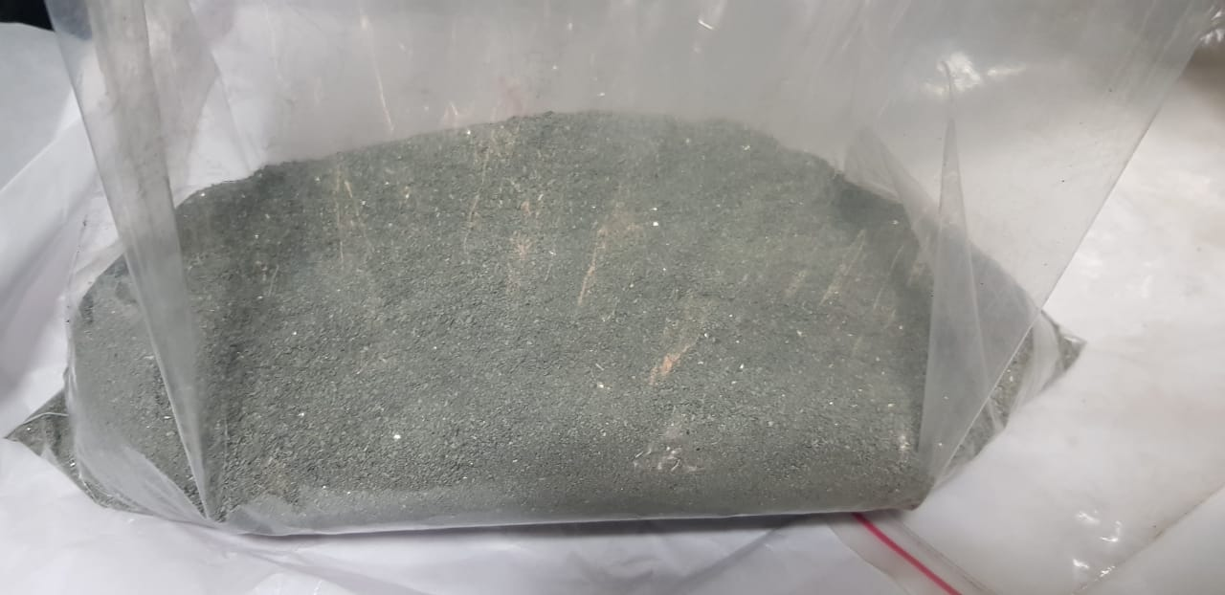
C. PULVERIZATION
The Magnets are crushed using roll crusher as shown. The avg size of the particles is about 0.5-1 mm.
The crushed powder is sent for ED-XRF analysis and the results are as shown (Table 1)
Roll Crusher used
Magnet Powder
ED-XRF Results: Table 1
Element | Percent | Element | Percent | Element | Percent | Element | %
Fe | 22.90% | Cu | 0.10% | Ga | 0.02% | Pr | 0.00%
Dy | 7.20% | Nd | 32.50% | La | 0.10% | Tb | 25.00%
Al | 4.00% | Er | 3.50% | Mo | 0.50% | Ti | 0.06%
Co | 1.80% | Eu | 1.00 | Ni | 1.30 | ---- | ----

Slide 12
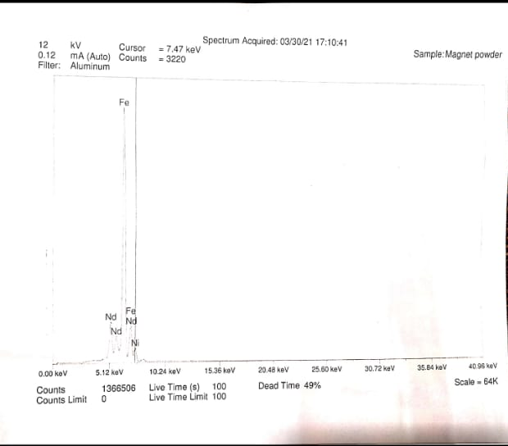
ED-XRF Spectrum of Magnet Powder

Slide 13
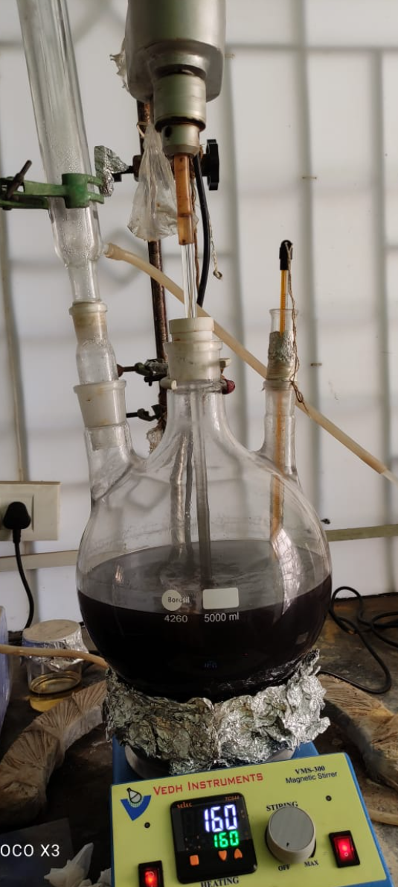
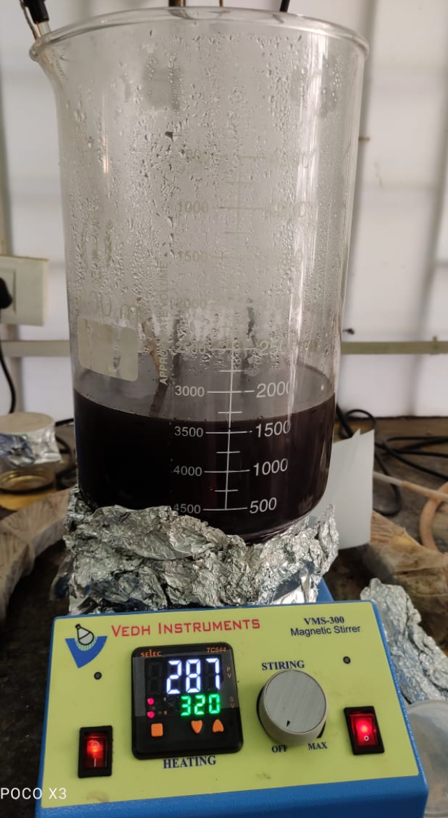
D. LEACHING:
250g of the crushed powder is weighed.
2500ml of 5.06M H₂SO₄ is prepared.
Add the H₂SO₄ solution in a beaker and
consequently powder is added.
Heat the beaker until it attains 70ºC.
Heat it for 2 Hours.
Let it attain room temperature.
Transfer the contents into an open beaker.

Slide 14
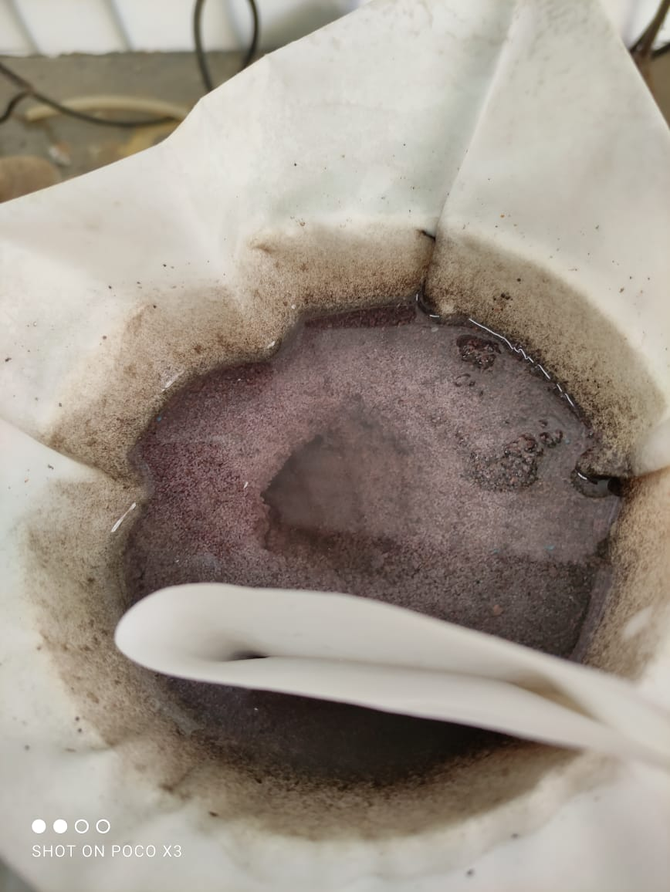
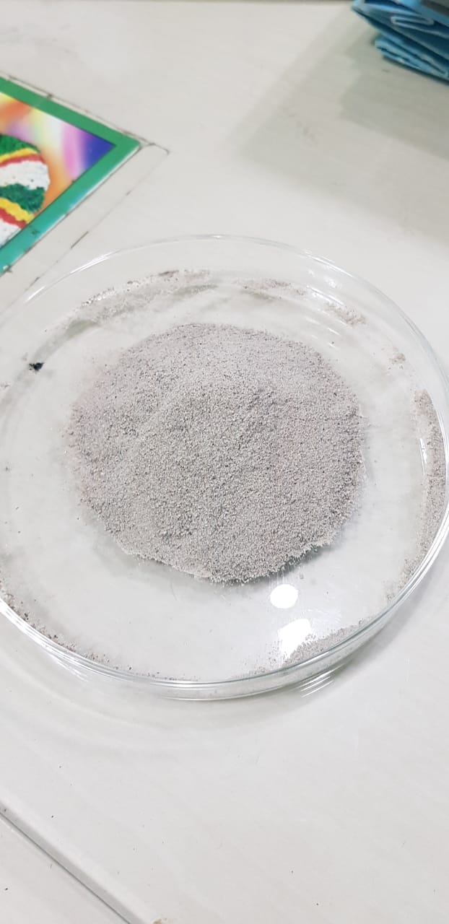
Evaporate the solution until it reduces to 1400ml.
Filter the contents.
Wash the residue with boiling hot water(DM) to remove Fe.
Dry the residue in an oven to remove moisture (110ºC, 1hr).
Crush the powder in an Agate Mortar.
Weigh 0.1g of the powder.
Dissolve it in Aqua regia.
The sample is analyzed using ICP-OES (Table 2).
Leach liquor’s volume is measured.
1ml of it is taken, made to 25ml and sent to ICP-OES analysis (Table 3).
Residue after filtration
Crushed residue¹

Slide 15
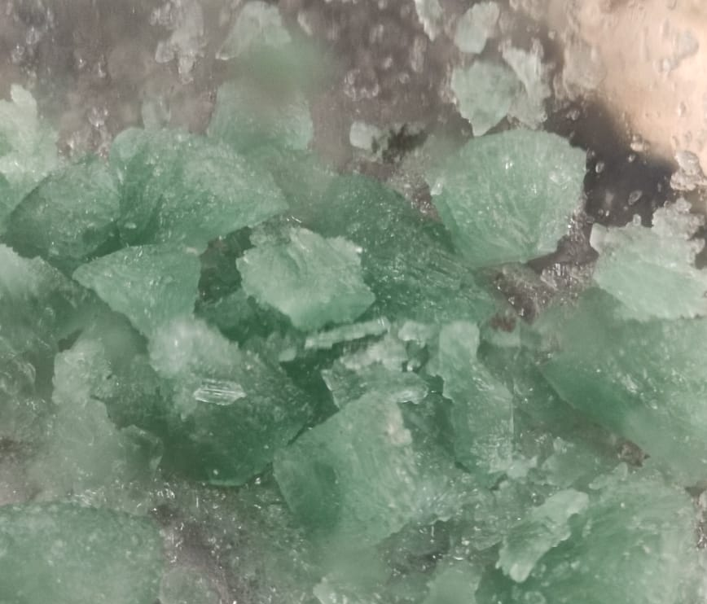
Results of Leaching:
Material | Weight(g)
Fe Crystals | 131.23
Residue(NdSO₄)¹ | 115.7
Solution | Volume(ml)
Leach Liquor | 965
ICP-OES Results of NdSO₄ powder: Table 2
Fe Crystals
Element | Percent | Element | Percent | Element | Percent | Element | Percent | Element | Percent
Al | 0.374% | Dy | 0.3172% | Ga | -0.314% | Mo | 0.0183% | S | 8.892%
B | 0.0048% | Er | 0.0013% | La | 0.0122% | Nd | 21.68% | Tb | 0.045%
Co | 0.0153% | Eu | 0.0365% | Li | 0.05% | Ni | 2.434% | Ti | 0.0009%
Cu | 0.195% | Fe | 0.6472% | Mn | 0.0036% | Pr | 4.115% | ---- | ----

Slide 16
ICP-OES Results of Leach Liquor : Table 3
Element | Percent | Element | Percent | Element | Percent | Element | Percent | Element | Percent
Al | 0.0022% | Dy | 0.0046% | Ga | 0.0005% | Mo | ~0.00% | S | 0.3469%
B | 0.0078% | Er | ~0.00% | La | ~0.00% | Nd | 0.018% | Tb | 0.0004%
Co | 0.0050% | Eu | ~0.005% | Li | ~0.00% | Ni | 0.0016% | Ti | ~0.00%
Cu | ~0.00% | Fe | 0.185% | Mn | 0.0002% | Pr | 0.0033% | ---- | ----

Slide 17
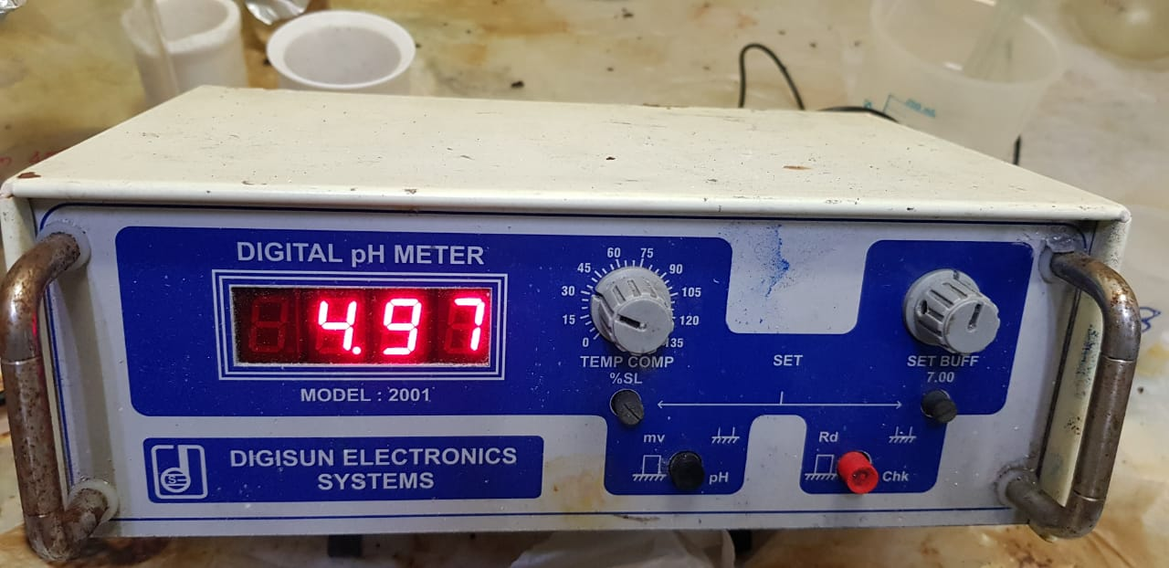
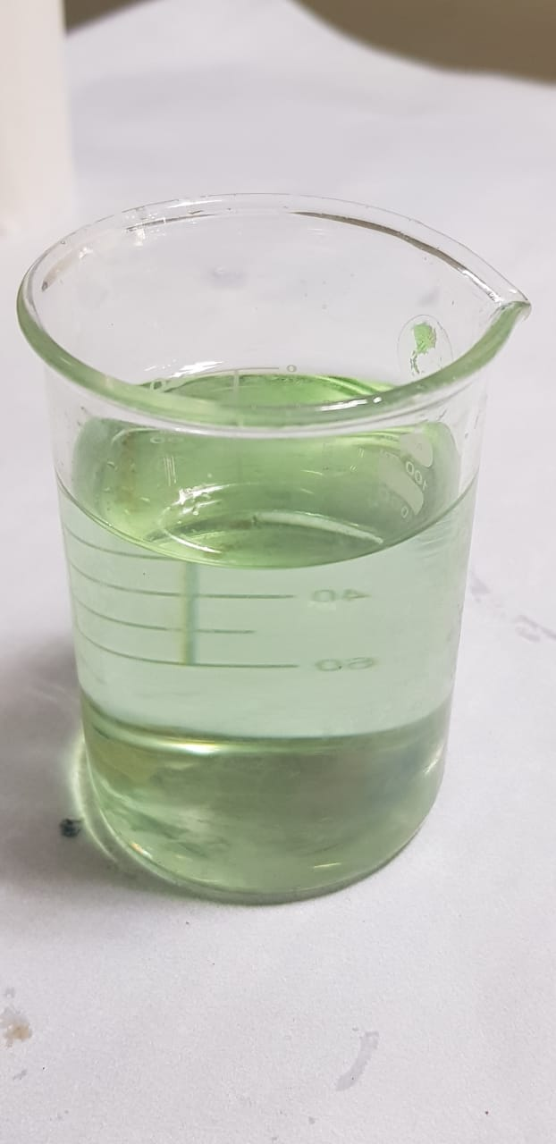
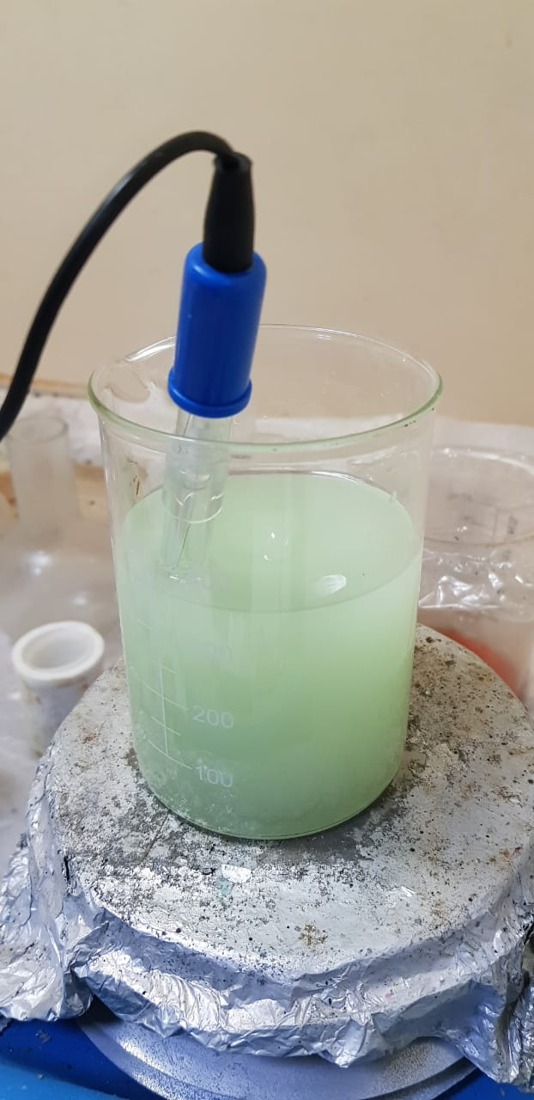
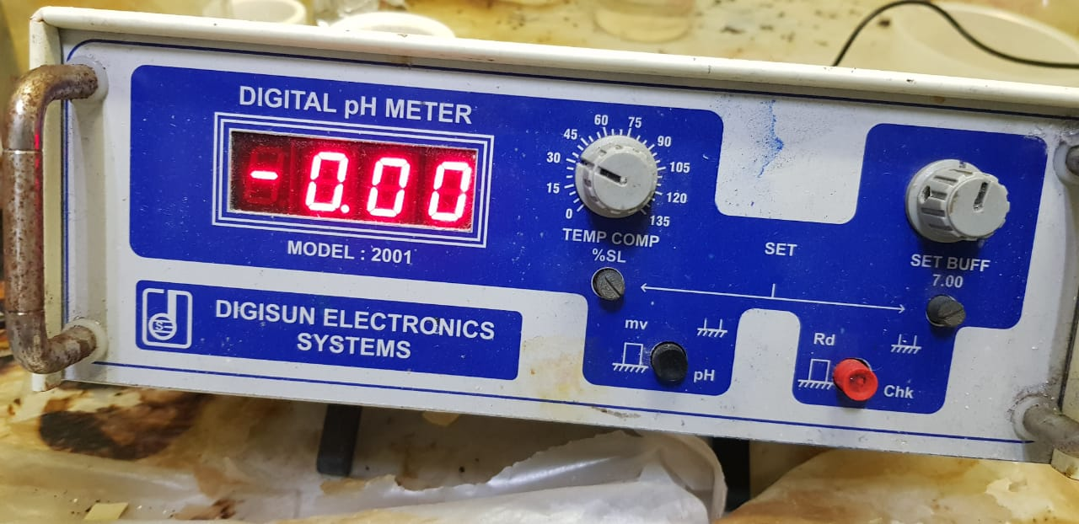
E. POST-LEACHING PROCESS:
Since rare earths are not reactive as other elements, there is no need of solvent extraction to be done.
5g of NdSO₄ powder is taken and dissolved in 45ml of HNO_{3.}
It is then made to 150ml then filter the contents.
Measure pH of filtrate using pH meter.
Till the pH of the filtrate attains 0, keep adding oxalic acid solution with constant stirring.
Before Adding Oxalic Acid
After Adding Oxalic Acid

Slide 18
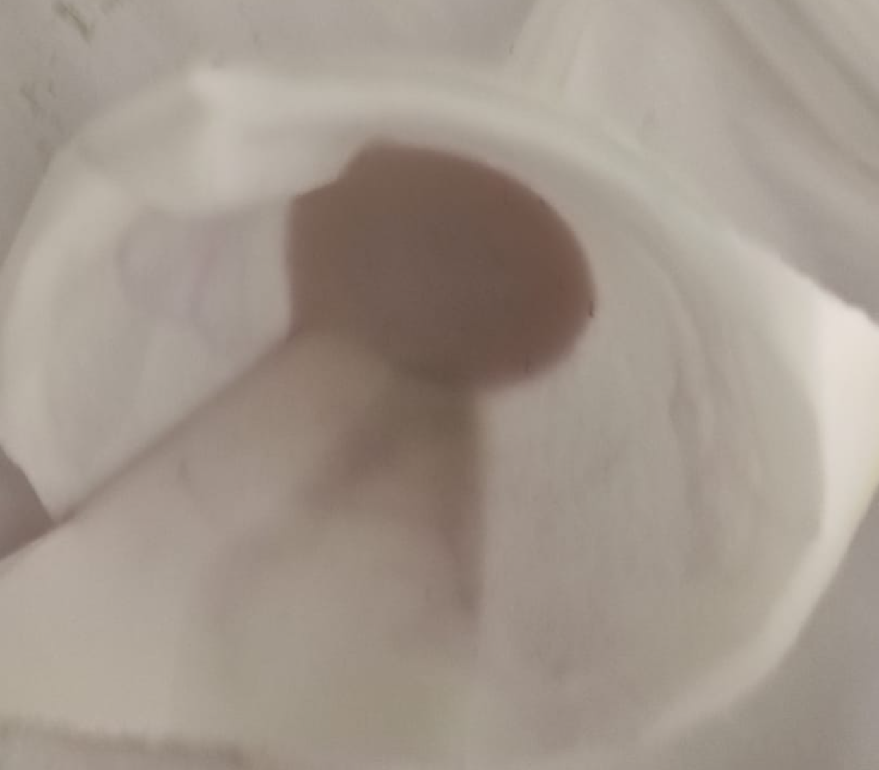
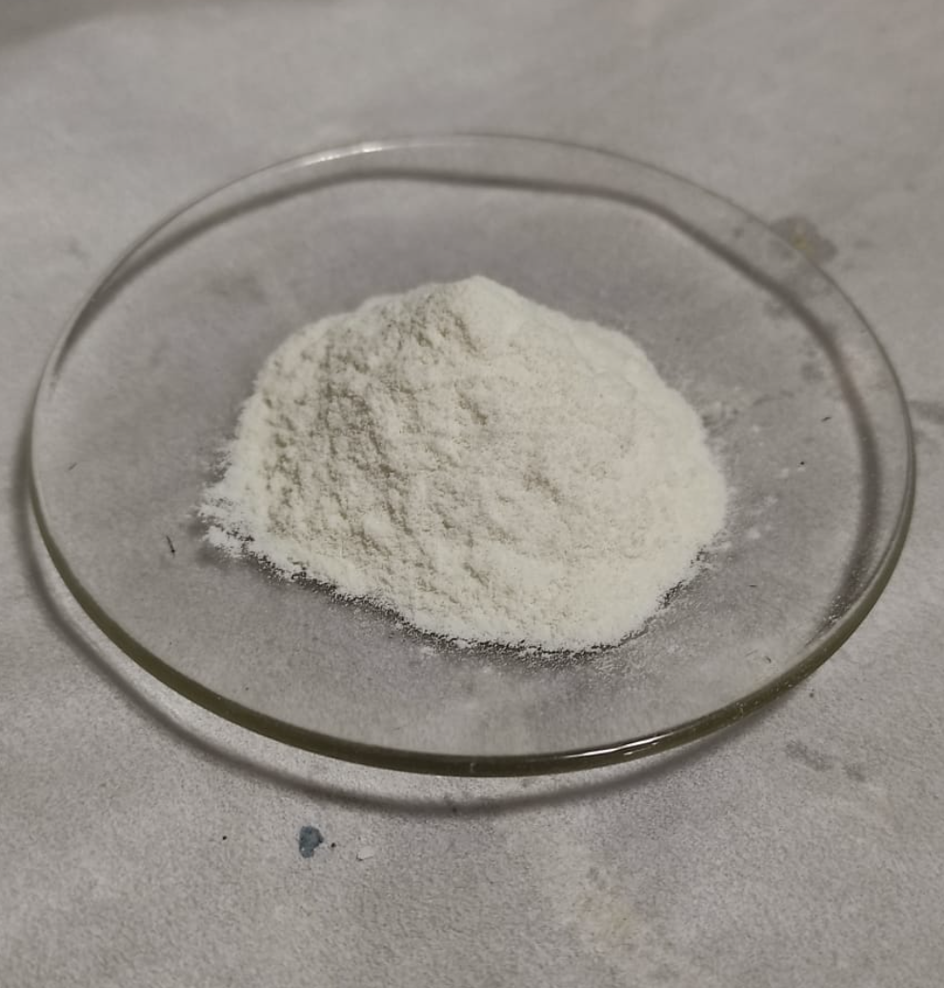
Filter the contents.
Wash the residue with hot DM water.
Heat it in a Hot Oven (110ºC, 1 Hr).
Weigh the powder (2.98g)
Take 0.1g of the powder, dissolve in Aqua regia, sent to ICP-OES analysis (Table-4).
Add the powder (2.97g) to a crucible (121.56g).
Place the crucible in a Muffle Furnace (850ºC, 1Hr).
Weigh the contents (1.6g).
Wash the powder with hot DM water, place it in a Hot Oven (70ºC, 1Hr)
Take 0.1g of the powder, dissolve in Aqua regia, sent to ICP-OES analysis (Table-5).
Nd-Oxalate Residue
Crushed Nd-Oxalate

Slide 19
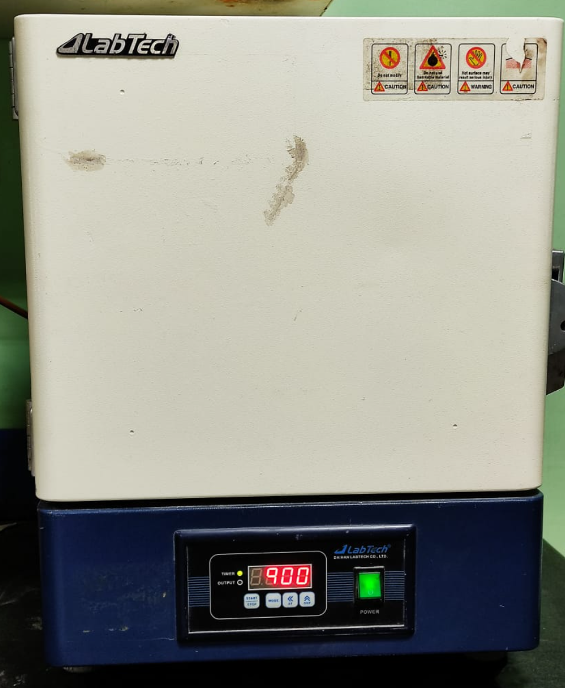
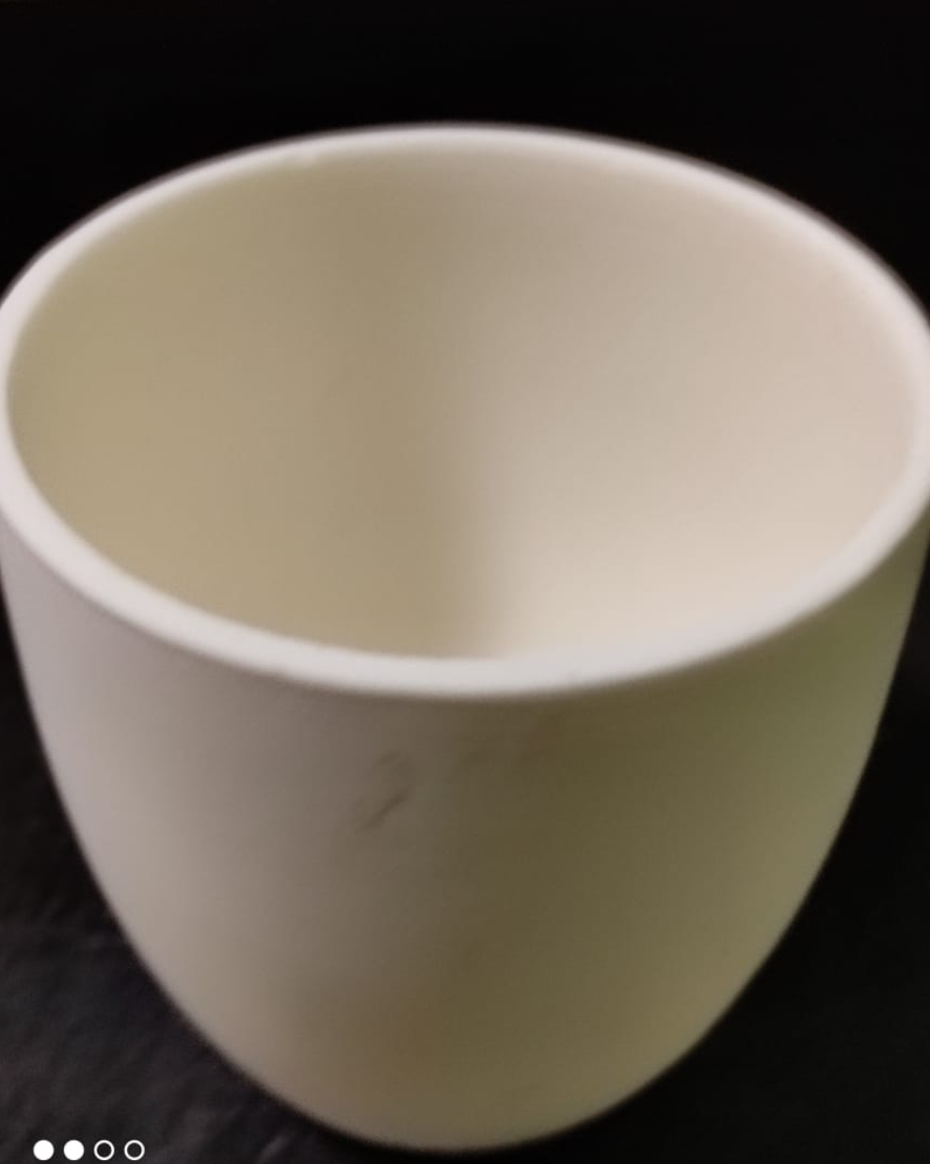
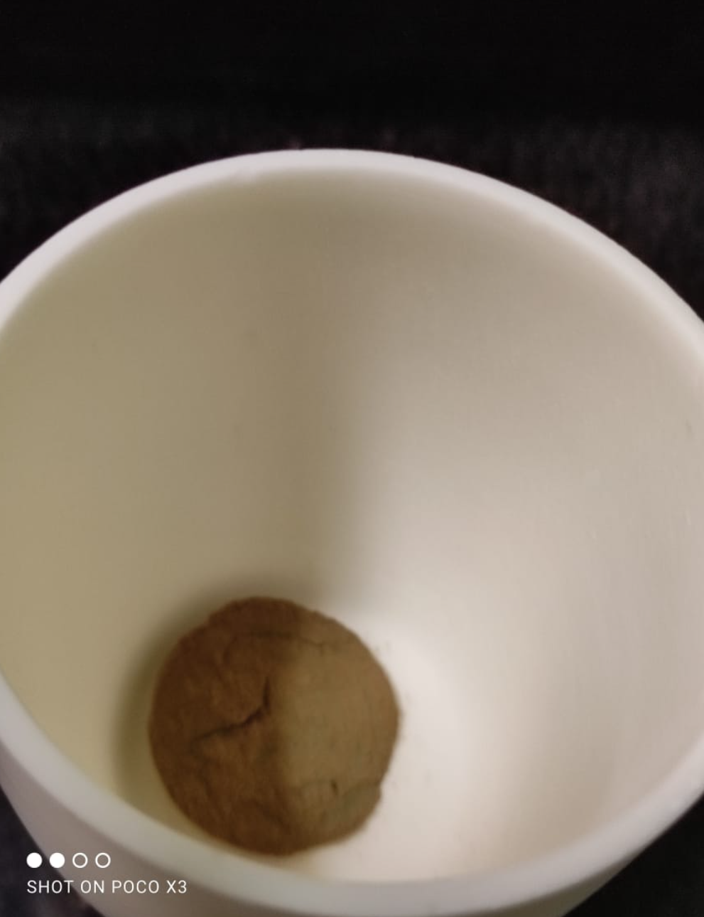
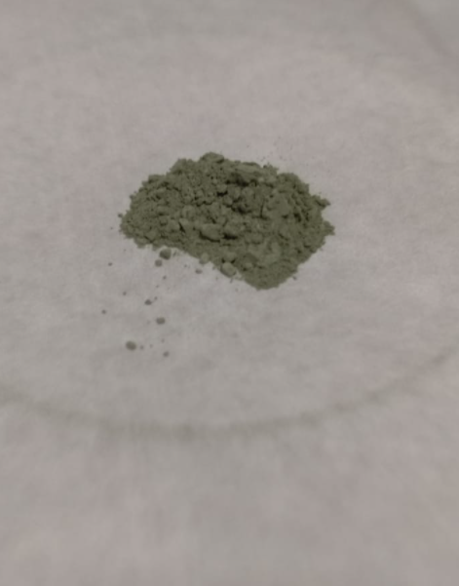
Results of Post-Leaching Process:
Muffle Furnace
Empty Crucible
Crucible with Nd Oxalate powder
Nd₂O₃
ICP-OES Results of Nd Oxalate : Table 4
Element | Percent | Element | Percent | Element | Percent | Element | Percent | Element | Percent
Al | 0.30% | Dy | 0.3472% | Ga | 0.007% | Mo | 0.0189% | S | 0.1062%
B | 0.0016% | Er | NA | La | 0.0117% | Nd | 22.02% | Tb | 0.479%
Co | 0.0131% | Eu | 0.0364% | Li | 0.0045% | Ni | 0.0142% | Ti | ----
Cu | 0.0298% | Fe | 0.056% | Mn | 0.0065% | Pr | 4.24% | ---- | ----

Slide 20
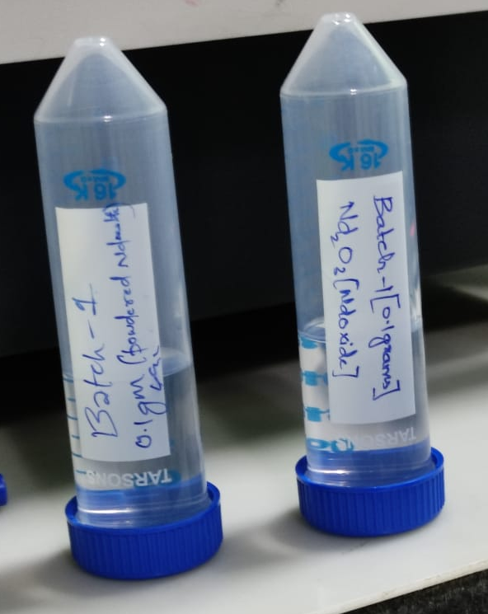
ICP-OES Results of Nd₂O₃: Table 5
Element | Percent | Element | Percent | Element | Percent | Element | Percent | Element | Percent
Al | 0.532% | Dy | 0.780% | Ga | 0.0150% | Mo | 0.0386% | S | 0.269%
B | 0.0028% | Er | ND | La | 0.0258% | Nd | 47.79% | Tb | 0.105%
Co | 0.0053% | Eu | 0.0815% | Li | 0.0028% | Ni | 0.0223% | Ti | ----
Cu | 0.0661% | Fe | 0.0280% | Mn | 0.0020% | Pr | 9.368% | ---- | ----
ICP-OES Samples of Nd-Oxalate and Nd₂O₃

Slide 21
CONCLUSION
Recycling and recovery of REEs (Nd, Pr, Dy, Tb) from Laptop permanent magnets are challenging due to their relatively small sizes used in consumer electrical and electronics, as well as in the conventional automotive industry. Shredding without pre-dismantling of Laptops will pose great difficulties for up-concentration of the permanent magnets.
There are many different types of metallurgical recovery methods identified from the literature; however, most of them have been studied for relatively clean and highly concentrated new or manufacturing magnet scrap and waste. At the same time, recovery of the major metals and materials in the dilute magnet waste stream (e.g., shredder products) is an important factor for the total success of the permanent magnet and REE recycling. It is believed that no single metallurgical process can be successful for the efficient recovery of the REEs from NdFeB permanent magnets, and a combination of hydrometallurgical, pyrometallurgical, and/or electrochemical technologies will be the future solution. It is expected that through the globally increasing efforts (Europe, Japan, USA, China) for the research and development, establishment of technologically and economically feasible REE magnet recycling industry could be realized in the near future, if the NdFeB permanent magnet market continue to develop.

Slide 22
REFERENCES
REE Recovery from End-of-Life NdFeB Permanent Magnet Scrap: A Critical Review (https://link.springer.com/article/10.1007/s40831-016-0090-4)
Identification and recovery of rare-earth permanent magnets from waste electrical and electronic equipment (https://www.sciencedirect.com/science/article/abs/pii/S0956053X17305214)
Process Recovery of Nd-Fe-B Permanent Magnets from Hard Disc Drives (https://www.longdom.org/open-access/process-recovery-of-ndfeb-permanent-magnets-from-hard-disc-drives-2167-0587-S6-008.pdf)
Recovery of rare earth elements by advanced processing technologies (https://digitalcommons.mtech.edu/cgi/viewcontent.cgi?article=1235&context=grad_rsch)

Slide 23
ACKNOWLEDGEMENT
We thank our parents for their unlimited support they give to us in every moment our life.
We express our sincere gratitude to our project guide Dr. B RAMESH CHANDRA (ASSOCIATE PROFESSOR OF METALLURGICAL ENGINEERING), whose guidance, encouragement and suggestions have contributed to the development of our ideas on the project and our guiding scientist at CMET-HYD Dr. U RAMBABU (M.Phil, Ph.D), Senior Scientist & Head of RoHS Department C-MET, Hyderabad and the entire wing of COE-RoHS, for their help, attention and time throughout the project.
We would also like to express our sincere thanks to Dr. K SRINIVASA VADAYAR (HEAD OF THE DEPARTMENT, DEPARTMENT OF METALLURGICAL ENGINEERING) for his support and encouragement.
We would also like to thank our beloved teaching faculty Dr. S DEVAKI RANI (PROFESSOR OF METALLURGICAL ENGINEERING) and Dr. R RAMA DEVI (ASSOCIATE PROFESSOR OF METALLURGICAL ENGINEERING), for their support and encouragement throughout our project.
VARDHINI SIVANGI (17011A0646)
VIJVAL VEMULA (17011A0651)

Slide 24
THANK YOU

